Slide 1
EASWARI ENGINEERING COLLEGE
Department of Information Technology
Final Review
A VOICE CONTROLLED AND VISION BASED SMART WHEEL CHAIR FOR PARALYZED PEOPLE
Supervisor
Dr. R. Priyatharshini
Project by
Muthu Selvam S(310617205044)
Ajai Kumar M (310617205004)
Kausic Narayanan M N(310617205025)

Slide 2
OUTLINE
Objectives
Abstract
Existing system/Literature Survey
Limitation of the existing system
Proposed system
System design
List of modules
Experimental Results
References

Slide 3
OBJECTIVE
To develop a Eye ball movement and voice command based wheel chair controller for paralyzed people.

Slide 4
ABSTRACT
There are 132 million disabled people who use a wheelchair in 34 developed and 156 developing countries, accounting for 1.86 percent of the global population. Furthermore, millions of people suffer from diseases that cause them to be unable to produce coordinated movement in any of their limbs or even their heads. So, using the Raspberry Pi, we devised a new way to provide paralyzed people with an eyeball-based and voice-controlled wheel chair access. The movement of the eye ball is tracked using the camera module, and the motor driver controls the direction of the wheel chair based on pupil location. The voice module receives user feedback through a cell phone. When an ultrasonic sensor senses an obstacle, the wheel chair will come to a halt. In the event of an emergency, people may send a message to their guardian through voice command via the message module.

Slide 5
LITERATURE SURVEY 1
A motion control method of intelligent wheelchair based on hand gesture recognition(2018)
In this paper Sarangi.P et al designed a device to regulate a motion-based approach based on the movement of the organs. Hand gestures are detected and measured by a Micro-electro-mechanical-systems (MEMS) instrument and then transmitted to a computer system via Bluetooth network, where a Markov algorithm is used for hand gesture movement training and another segmentation algorithm is used to classify gestures. However, the main concern occurs when a patient is unable to move all of his or her body parts.

Slide 6
LITERATURE SURVEY 2
A low cost Human Computer Interface for Disabled People based on Eye Blink detection using Brain Signal(2017)
Rajesh kannan introduced a device to detect and capture eye movements, the system described in this paper uses a Brain Controlled Interface based approach. Every minute, the patient's brain waves are recorded, and the data is used to determine whether or not eye motion is present, and the wheelchair is then pushed based on that information. However, the biggest disadvantage of this approach is that using Brain Wave Sensors all of the time makes paralyzed people nervous and makes them reliant on external devices.

Slide 7
LITERATURE SURVEY 3
Autonomous camera based eye controlled wheelchair system using Eye ball cursor movement(2019)
Dr. zhang and pheng built a system for the disabled people who are unable to perform activities with their hands or legs are the subjects of this paper. A graphical user interface (GUI) is being created for such handicapped people. The GUI is shown on a screen with options for a variety of tasks. Up to this point, four separate motions have been performed and regulated using the GUI: forward, backward, left, and right.

Slide 8
LITERATURE SURVEY 4
Integrating Human Input with autonomous behaviors on an Intelligent Wheelchair Platform(2020)
An IR based eye pupil detection device was suggested by R. Barea, L. Boquete which consist of an IR transmitter and IR receiver used to drive the wheelchair. The light is transmitted over the iris by the IR transmitter, and the reflected light is absorbed by the IR receiver. The controller can detect the user's intention of wheelchair movement based on the strength of reflected light absorbed by the receiver. The importance of this procedure is that it can have reliable results; however, this device has an effect on the eye and can cause vision loss.

Slide 9
LIMITATIONS OF EXISTING SYSTEM
GUI and cursor based methodology was used in the existing system which requires a eye blink every time as it makes the system a uncomfortable one for the user.
Infrared rays are also used to control the wheel chair by using eye ball movement which is very inefficient as it requires a external device every time and it is also harmful.
Using Brain Wave Sensors all the time makes paralyzed people uncomfortable.
Handicapped people will always be dependent on third persons or external device such as remote controller if they use remote control type of wheel chair controlling system.
Gesture based wheel chair cannot be used by Paralyzed people as free movement of hands are not possible by them.

Slide 10
PROPOSED SYSTEM
In our system eye is focused by the camera and live video is captured. Then by using OpenCV we need to find out the centroid of the eyeball.
Then the different variation on pupil position get different command set for wheelchair. By tacking the eyeball movement, we can move the wheel chair accordingly.
The motor driver will control both speed and direction to enable the wheelchair to move forward, left, right and stop.
It is very useful for Elderly and disabled people who needs guidance to live. We can start and stop functioning of wheelchair by blinking eye.
Also person can control the wheelchair by giving voice commands using a smartphone.

Slide 11
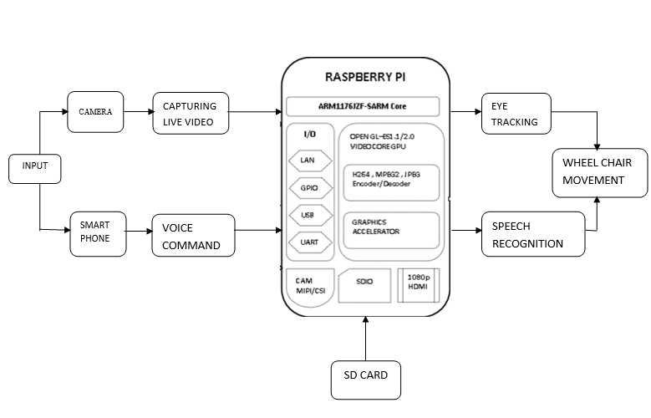
SYSTEM DESIGN
SYSTEM DESIGN

Slide 12
LIST OF MODULES
Eye ball movement tracker
Speech synthesis and recognition
Wheel chair motor driver

Slide 13
MODULE 1
EYE BALL MOVEMENT TRACKER:-
In this module eye pupil detection and eye tracking is done based on computer vision technology.
A webcam is a video camera that feeds or streams an image or video in real time to or through a computer to a computer network, such as the Internet.
After the detection of proper face, it will trying to detect the eye inside the face region of interest.
For the face detection Haar cascade algorithm is used.
Once the eye pupil from the face is recognized the wheel chair will start to move based on the eye ball movement.

Slide 14
MODULE 1
Algorithm:-
Haar-Cascade is an AI based object location calculator used to identify features in an image.
At first, the calculation wants plenty of positive-images and negative to arrange the classifier.
In the mean-time, have got to disencumber places of interest from it.
For this, Haar marks the utilized image area that is beneath. They’re ample constant as of our convolutional- portion.

Slide 15
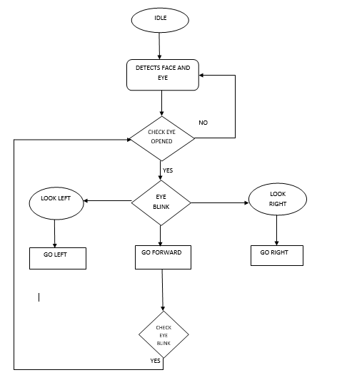
MODULE 1
FLOW CHART

Slide 16
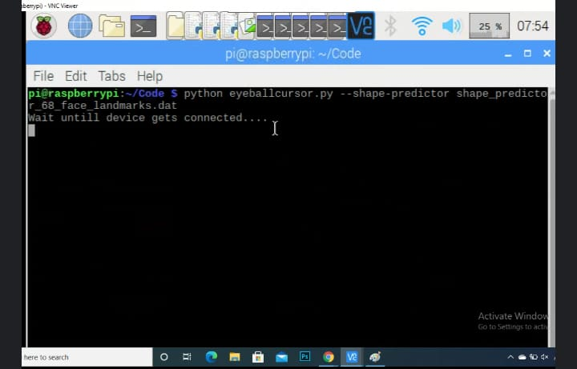
INTERMEDIATE RESULT 1
The web camera, which is positioned opposite the user, is used to record the user's eye movement. The live video is shot using a 720p HD camera with an interpolated 20M pixel still image and a 2.1 M pixel display range. With a frame rate of 30 frames per second, the video camera continuously monitors the field of view. Only after the face has been extracted from the video the eye region be identified in the frame.

Slide 17
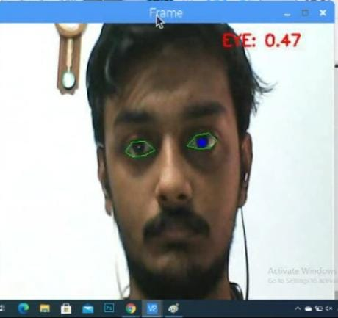
INTERMEDIATE RESULT 1
In this figure the person looks straight into the camera and the pupil is detected from the live video stream which is processed by the system as normal position and therefore makes the wheel chair halt

Slide 18
MODULE 2
SPEECH SYNTHESIS AND RECOGNITION:-
A Voice mode selection is made available in case of
indoor functioning using Smartphone.
A secured Bluetooth connection is required to connect and transfer the given commands for processing.
A Voice-Bot app is installed to interact with the system.
The voice module takes user input for functioning, i.e., the user has to give commands and these commands are compared with built in commands in the application to move the wheelchair in a different direction.

Slide 19
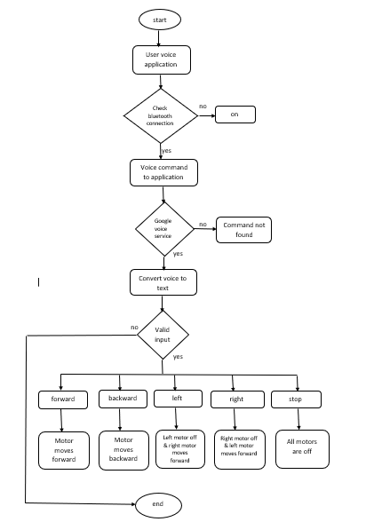
MODULE 2

Slide 20
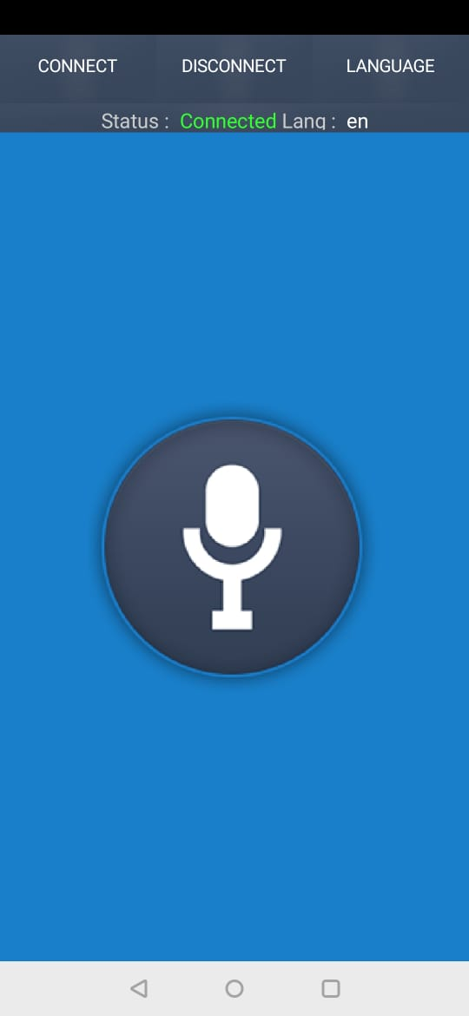
INTERMEDIATE RESULT 2
This figure represents the user interface of the application to control Wheelchair. This application is installed in the smart phone for sending voice commands and emergency message.

Slide 21
MODULE 3
WHEEL CHAIR MOTOR DRIVER :-
A small wheel chair prototype is made using dc motor for the movement of wheel chair.
The two-channel relay board is used to control the Motor driving IC and in- order to supply power a battery is used.
Raspberry-Pi is integrated with Motor driving circuit, which assists in operating the system.
This module setup is made to track the eye movements and record voice as input to steer the wheelchair as desired by the user.

Slide 22
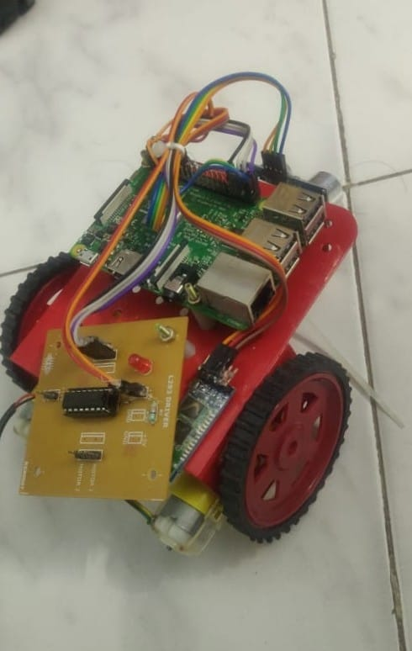
INTERMEDIATE RESULT 3
Wheel chair setup
.

Slide 23
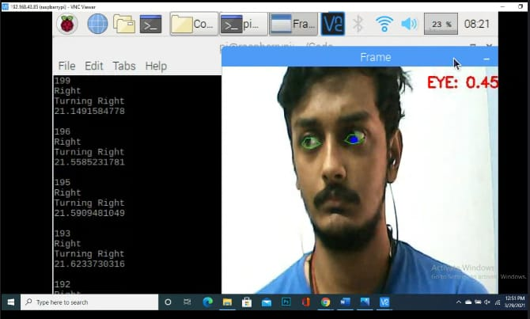
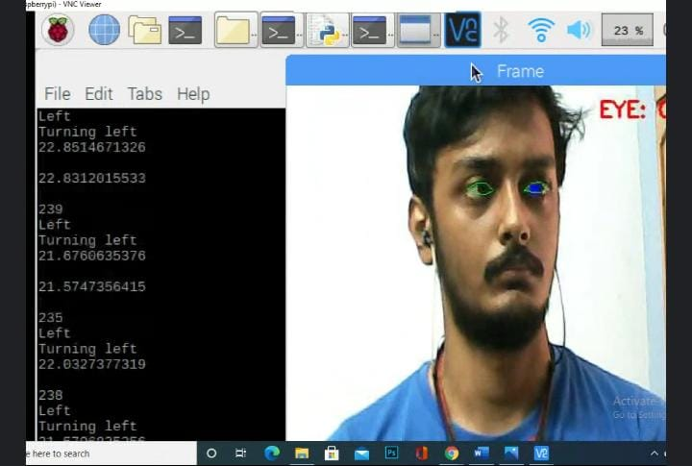
EXPERIMENTAL RESULTS
(a)
(b)

Slide 24
EXPERIMENTAL RESULTS
Figure (a) shows a person with movement of eye in right direction, the pupil is detected based on eyeball movement that leads to the right turn of wheel chair.
Figure (b) depicts a person with left eye movement, the pupil is detected based on motion of the eyeball that corresponds to the left turn of wheel chair.

Slide 25

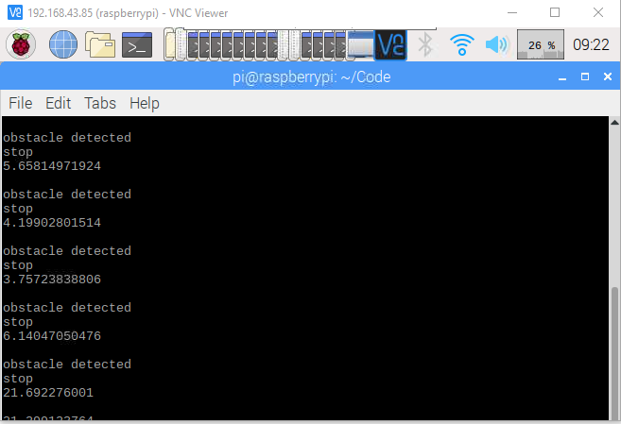
EXPERIMENTAL RESULTS
(c)
(d)

Slide 26
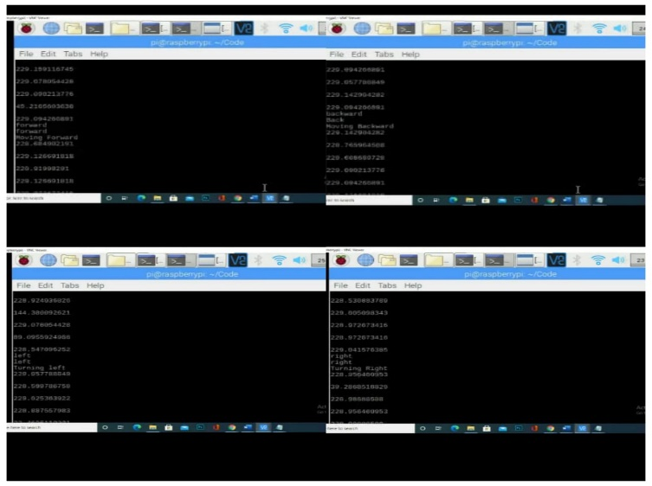
EXPERIMENTAL RESULTS
(e)

Slide 27
EXPERIMENTAL RESULTS
In case of any emergency the user can alert the guardian by using voice module messaging platform which is shown in figure(c).
Figure (d) shows the movement of wheel chair, when ultra sonic sensor detects any obstacle found in the path, the wheel chair stops.
Figure (e) shows the output of voice module where user gives the input through the voice command for forward, backward, left and right movements of the wheel chair.

Slide 28
PERFORMANCE ANALYSIS
The model is ready for performance analysis. The proposed model is
compared to two other existing models.
The traditional model is implemented and drives the input application. Since the duration of requests varies for each and every model, we have calculated the performance by running the algorithm thrice a week.
The proposed system is compared to the existing systems on the basis of
three criteria:
i. The number of datasets given as input
ii. The runtime in seconds averaged over solved problems
iii. The average cost of the solution obtained

Slide 29
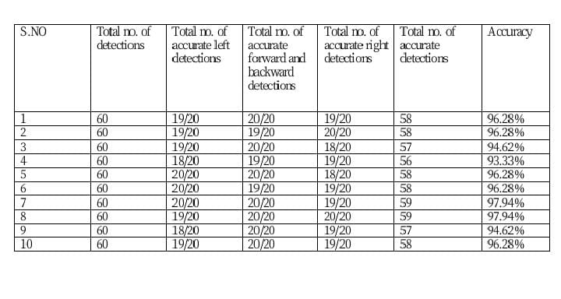
PERFORMANCE ANALYSIS
The above table shows the performance measure of eye movement tracker module while moving left, forward, backward, right.

Slide 30
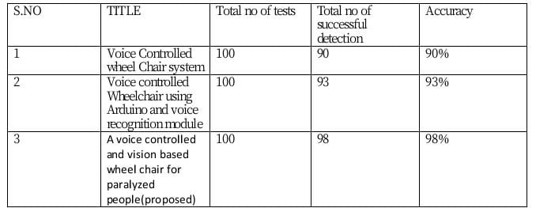
PERFORMANCE ANALYSIS
The table above shows the comparison of performance analysis with the existing systems for voice controlled wheel chair.

Slide 31
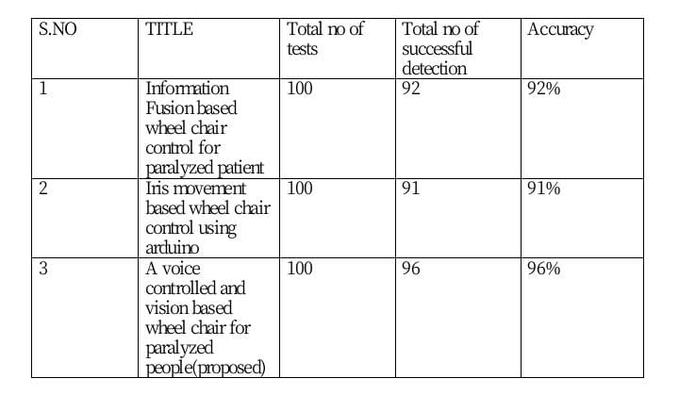
PERFORMANCE ANALYSIS
The above table shows the comparison of performance analysis with the existing systems for eye controlled wheel chair.

Slide 32
REFERENCES
[1] Parikh, S. P., Grassi, V., Kumar, V., & Okamoto, J. (2018). Integrating human inputs with autonomous behaviors on an intelligent wheelchair platform. IEEE Intelligent Systems, 22(2), 33-41.
[2] Nishimori, M., Saitoh, T., & Konishi, R. (2019, September). Voice controlled intelligent wheelchair. In SICE Annual Conference 2019 (pp. 336-340). IEEE.
[3] Lu, T. (2019, June). A motion control method of intelligent wheelchair based on hand gesture recognition. In 2020 IEEE 8th Conference on Industrial Electronics and Applications (ICIEA) (pp. 957-962). IEEE.
[4] Vijayakumar, C., Kumar, M. P., Sivaji, S., Sadulla, S., Prathiba, J., & Kumar, K. V. (2020, December). Sensors based automated wheelchair. In 2020 International Conference on Green Computing, Communication and Conservation of Energy (ICGCE) (pp. 439-443). IEEE

Slide 33
REFERENCES
[5] Fattouh, A., Horn, O., & Bourhis, G. (2019). Emotional BCI control of a smart wheelchair. International Journal of Computer Science Issues (IJCSI), 10(3), 32..
[6] Vinod, V. M. (2018, March). EOG based wheelchair control for quadriplegics. In 2018 International Conference on Innovations in Information, Embedded and Communication Systems (ICIIECS) (pp. 1-4). IEEE.
[7] Zhang, P., Ito, M., Ito, S. I., & Fukumi, M. (2020, December). Implementation of EOG mouse using Learning Vector Quantization and EOG-feature based methods. In 2020 IEEE Conference on Systems, Process & Control (ICSPC) (pp. 88-92). IEEE.
[8] Ali, S. J., Kumar, R. P., Madhunikitha, P. V., Pushpalatha, A., & Manjunath, K. (2019). Autonomous Camera Based Eye Controlled Wheel Chair Using Raspberry-Pi. International Journal Of Innovative Technology And Research, 5(2).

Slide 34
THANK YOU

